Slide 1

MAMBA WITH MARKOV CHAIN ON TIME SERIES DATASETS WITH DOMAIN GENERALIZATION
22AIE213 – Machine Learning
CH.SC.U4AIE23003 - ANIRUDH V
CH.SC.U4AIE23048 - NITHYA SHANKAR S
CH.SC.U4AIE23061 - VIGNESHWARRAN S

Slide 2
INTRODUCTION
Time series forecasting is crucial in fields like finance, healthcare, and climate science, but existing models are inefficient and inflexible. While Mamba, a state-space sequence model, is good at modeling long-term dependencies in an efficient manner, it is unresponsive to sudden changes. Markov Chains, on the other hand, are adept at modeling short-term changes in state utilizing probabilistic methods. In this work, we integrate Markov Chains with Mamba to achieve better forecasting accuracy, flexibility, and computational efficiency.

Slide 3
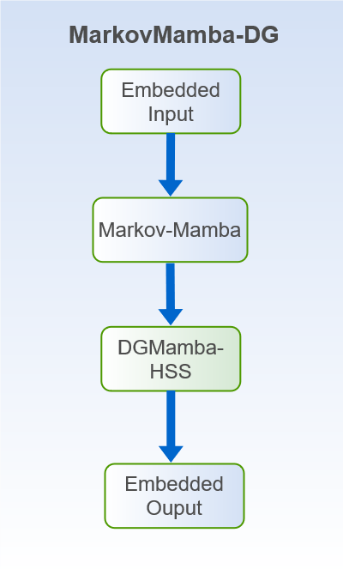

Slide 4
PROBLEM STATEMENT
To Develop a hybrid model combining Hidden Markov Models (HMMs) and Mamba for domain generalization over varied sequential datasets. The model should successfully classify binary classes with better generalization and domain-specific bias suppression by leveraging the capacity of HMMs to capture temporal dependencies in sequential patterns and the efficient, linear-time sequence processing and selective state space properties of Mamba. This strategy aims to capitalize on better feature extraction through Mamba's hardware-aware architecture and probabilistic state transitions from HMMs to obtain strong, domain-invariant performance across different datasets, like time series, natural language, or other sequential domains, with a single codebase.

Slide 5
OBJECTIVE
The objective of this study is to create a hybrid forecasting model utilizing Mamba's long-range effectiveness and probabilistic state transitions in Markov Chains. This hybridization will support greater responsiveness to abrupt changes with computational efficiency being preserved and since this suppresses the domain as in “Domain Generalization” and this ensures that single code base can be used for any domain of datasets

Slide 6
METHODOLOGY
Binance Full History dataset
Weather Dataset
The Binance Full History dataset provides minute-level cryptocurrency trading data for BTC, ETH, and BNB pairs since 2017, useful for market analysis and ML projects. It preprocesses data to classify market states ("Normal" or "Active") based on price movements, volatility, and volume. A transition matrix visualizes state probabilities, aiding in understanding market dynamics.
The meteorological dataset contains 52,696 rows and 22 columns, including parameters like temperature, pressure, humidity, wind velocity, and solar radiation. Strong correlations exist between temperature, vapor pressure, and potential temperature, while solar and photosynthetic radiation are nearly identical. Rainfall shows a moderate correlation with its duration, while some variables have weak associations.

Slide 7
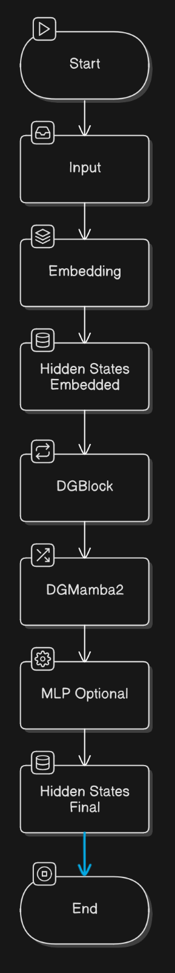
Architecture Diagram

Slide 8
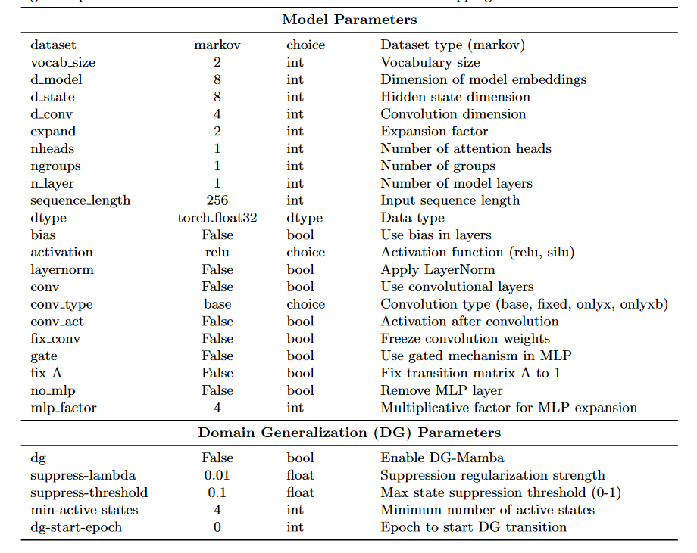
Model Parameters

Slide 9
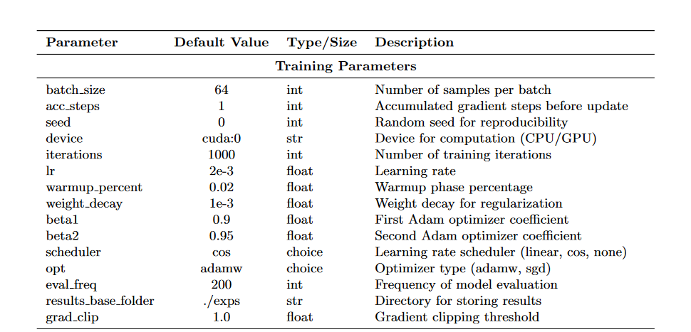

Slide 10
Results and Discussion
The DG-Mamba model excels in capturing short-term dependencies, making it highly effective for scenarios with rapid changes and domain shifts, such as weather prediction. It utilizes hidden state suppression to prevent overfitting to domain-specific variations, enhancing generalization. However, its ability to handle long-term dependencies is limited, as it does not model transitions over extended periods.
In contrast, the Markov-Mamba model is designed for long-term dependencies, using a Markovian transition process and a transition matrix to capture state changes over time. This makes it ideal for time-series data with cyclic or seasonal trends but less effective for short-term variations.
The hybrid model, combining DG-Mamba and Markov-Mamba, leverages the strengths of both approaches. It effectively handles both short-term and long-term dependencies, making it particularly suitable for applications like weather forecasting, where both rapid fluctuations and long-term patterns are crucial. However, it comes with higher computational costs and requires careful fine-tuning for optimal performance.

Slide 11
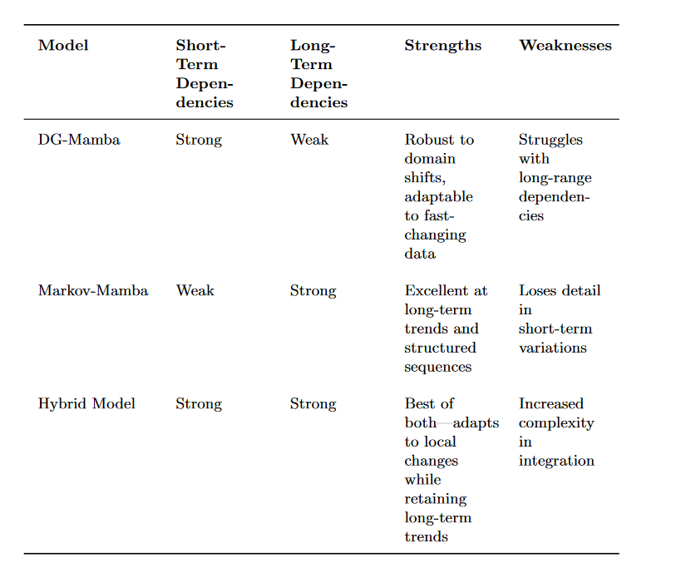

Slide 12
Literature Review
S.NO | Title | Author Journal Year | Methodology/Algorithms/Architecture used | Merits | Demerits | Research gap
01 | From Markov to Laplace: How Mamba In-Context Learns Markov Chains DOI:https://doi.org/10.48550/arXiv.2502.10178 | Marco Bondaschi, Nived Rajaraman, Xiuying Wei, Kannan Ramchandran, Razvan Pascanu, Caglar Gulcehre, Michael Gastpar, Ashok Vardhan Makkuva 2025 | The paper uses MambaZero, to theoretically analyze how Mamba can represent Laplacian smoothing. MambaZero retains only the embedding layer, convolution within the Mamba block, and the linear layer | It provides a novel framework for a precise theoretical and empirical study of Mamba's in-context learning (ICL) via random Markov chains. | Bad at Short-term Dependencies .Mamba's in-context learning (ICL) can be worse than transformers. | There is a lack of a fundamental understanding of Mamba and its underlying learning mechanisms, especially regarding its in-context learning (ICL) abilities. The theoretical analysis of Mamba's capabilities, particularly in handling higher-order Markov chains, is limited and becomes intractable as the order increases.

Slide 13
Literature Review
S.NO | Title | Author Journal Year | Methodology/Algorithms/Architecture used | Merits | Demerits | Research gap
02 | DGMamba: Domain Generalization via Generalized State Space Model DOI: | Shaocong Long, Qianyu Zhou, Xiangtai Li, Xuequan Lu, Chenhao Ying, Yuan Luo, Lizhuang Ma, Shuicheng Yan 2024 | Hidden State Suppressing (HSS): This component mitigates the influence of hidden states associated with domain-specific features during output prediction. Semantic-aware Patch Refining (SPR): This component encourages the model to concentrate more on objects rather than context | DGMamba achieves strong generalizability with global receptive fields and linear complexity. It introduces HSS and SPR to improve generalizability by focusing on objects over context. | They didn’t explicitly mention any demerits but it is not good at long term dependencies. . | Mamba, with its linear complexity and global receptive fields, has potential in DG but faces challenges due to hidden state issues and inappropriate scan mechanisms. There is a need to improve the generalizability of Mamba-based models and understand what hinders Mamba from addressing distribution shifts in DG

Slide 14
Literature Review
S.NO | Title | Author Journal Year | Methodology/Algorithms/Architecture used | Merits | Demerits | Research gap
03 | Sequential Order-Robust Mamba for Time Series Forecasting DOI: | Seunghan Lee, Juri Hong, Kibok Lee, and Taeyoung Park. 2024 | SOR-Mamba addresses sequential order bias in Mamba-based time series forecasting by using a regularization strategy to align embeddings from original and reversed channel orders. It removes 1D-convolutions and employs channel correlation modeling to improve forecasting accuracy and efficiency. | SOR-Mamba improves time-series forecasting by reducing sequential order bias, enhancing robustness, and achieving higher efficiency with fewer parameters. | The removal of 1D convolution may impact datasets with strict sequential order (e.g., traffic sensor data). Its performance is best when a fixed channel order is maintained, limiting flexibility for highly dynamic data. . | Existing time-series forecasting models struggle with sequential order bias, especially when capturing channel dependencies (CD) in unordered data. SOR-Mamba addresses this gap by introducing a regularization strategy and removing 1D convolution, but further improvements are needed for datasets with inherently ordered channels.

Slide 15
Literature Review
S.NO | Title | Author Journal Year | Methodology/Algorithms/Architecture used | Merits | Demerits | Research gap
04 | A Mamba Foundation Model for Time Series Doi: | Haoyu Ma, Yushu Chen, Wenlai Zhao, Jinzhe Yang, Yingsheng Ji, Xinghua Xu, Xiaozhu Liu, Hao Jing, Shengzhuo Liu, Guangwen Yang​ ²⁰²⁴ | TSMamba, a Mamba-based foundation model that captures temporal dependencies using forward and backward encoders. A two-stage transfer learning approach allows the model to generalize across different datasets while incorporating a compressed attention module for cross-channel relations​ | TSMamba reduces computational complexity with a linear-time Mamba architecture, making it highly efficient for long-term time-series forecasting. It also enhances data efficiency using two-stage transfer learning, allowing adaptation with minimal training data​ | While TSMamba improves efficiency, its assumption of channel independence may limit cross-channel dependency learning. Additionally, it relies on large-scale pretraining, making fine-tuning necessary for certain datasets | Most time-series forecasting models depend on Transformer-based architectures, which suffer from quadratic complexity and struggle with long-range dependencies. This paper proposes TSMamba to overcome these challenges by using a state-space model (SSM) with linear complexity, improving forecasting accuracy while reducing computational costs

Slide 16
Literature Review
S.NO | Title | Author Journal Year | Methodology/Algorithms/Architecture used | Merits | Demerits | Research gap
05 | Is Mamba Effective for Time Series Forecasting? | Zihan Wang, Fanheng Kong, Shi Feng, Ming Wang, Xiaocui Yang, Han Zhao, Daling Wang, and Yifei Zhang 2024 | Simple-Mamba (S-Mamba), which utilizes bidirectional Mamba layers to capture inter-variable correlations, a feed-forward network to encode temporal dependencies, and a linear mapping layer for final predictions | S-Mamba improves time-series forecasting by reducing computational overhead while maintaining high accuracy, making it more efficient than Transformer-based models. It also requires lower memory usage and training time, making it suitable for real-time applications​ | Despite its efficiency, S-Mamba struggles with datasets that have weak inter-variable correlations, limiting its adaptability. Additionally, its performance declines when handling non-periodic data, making it less effective for certain time-series forecasting tasks​ | Existing models face high computational costs and inefficiency in handling diverse time-series structures; the study highlights the need for improved adaptability to non-periodic and weakly correlated data​

Slide 17
Literature Review
S.NO | Title | Author Journal Year | Methodology/Algorithms/Architecture used | Merits | Demerits | Research gap
06 | Learning Interpretable Deep State Space Model for Probabilistic Time Series Forecasting | Longyuan Li, Junchi Yan, Xiaokang Yang, and Yaohui Jin Shanghai Jiao Tong University 2024 | The approach integrates a deep state-space model with a nonlinear emission and transition network, utilizes recurrent neural networks (RNNs) for capturing dependencies, and employs Monte Carlo simulations to generate probabilistic forecasts while incorporating the ARD network to filter relevant exogenous variables​ | The proposed model handles arbitrary data distributions, provides interpretable forecasts by leveraging an automatic relevance determination (ARD) network, and effectively models uncertainty in exogenous variables, leading to more robust and accurate predictions​ | Despite its advantages, the model relies heavily on Monte Carlo simulations, which can be computationally expensive, and its performance may degrade when dealing with highly sparse or unpredictable exogenous variables​ | Existing probabilistic time-series models struggle with incorporating exogenous variables while ensuring interpretability. This paper proposes a deep state-space model that automatically identifies relevant factors and models their uncertainty.

Slide 18
Conclusion
Mamba-based models offer a promising approach for time-series forecasting with domain generalization, combining state space models' efficiency and scalability with robustness across varied domains. Future research should focus on temporal-specific architectures, domain-invariant learning, and benchmarking across real-world data. This could enable Mamba to deliver consistent predictions in dynamic environments where traditional models struggle. Potential applications include healthcare, climate science, and other fields requiring cross-domain adaptability.

